Slide 1

Where will I ever use this?
https://www.youtube.com/watch?v=L5-YeFUTxj0

Slide 2
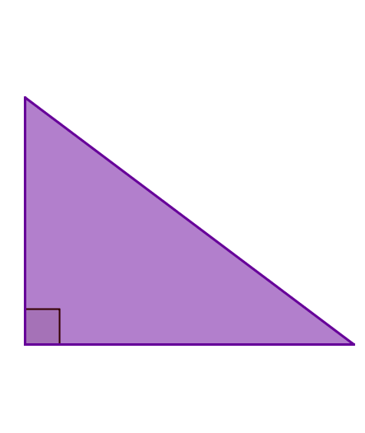
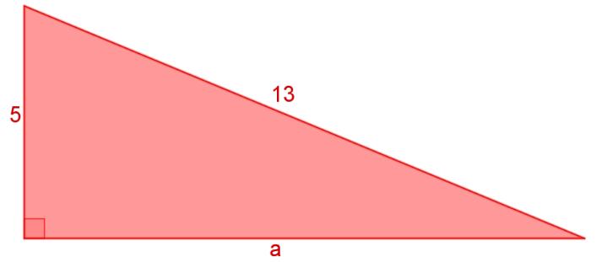
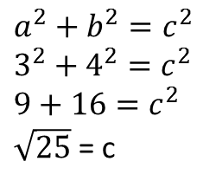
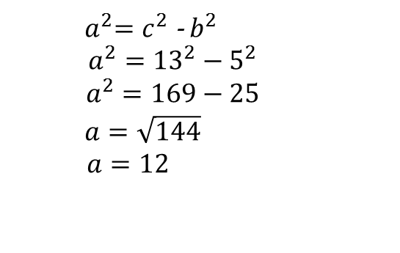
24
7
30
Date
Pythagoras Revision
EQ – How do I use Pythagoras theorem to find any side of a triangle
To find the length of the hypotenuse.
Pythagoras’ Theorem states the longest side squared is equal to the short sides squared and added together
c
$$a^{2}+b^{2}=c^{2}$$
$$3^{2}+4^{2}=c^{2}$$
$$9+16=c^{2}$$
$\sqrt{25}$ = c
3
To find the length of any of the shorter sides.
4
Find the length of a.
${ a}^{2}=c^{2}$ - $b^{2}$
$$a^{2}={13}^{2}−5^{2}$$
$$a^{2}=169−25$$
$$a=\sqrt{144}$$
$a=12$
13
5
a
7

Slide 3
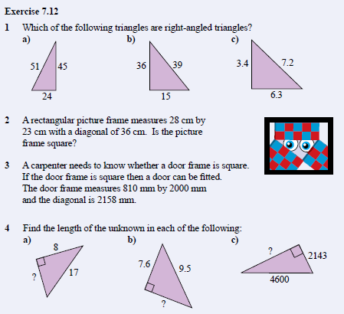
Complete Chapter Review ex 7.12 Page 101

Slide 4
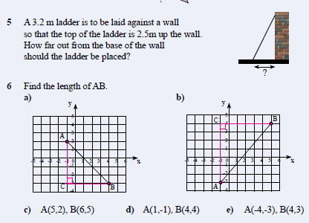
Complete Chapter Review ex 7.12 Page 101

